Slide 1

Group 3: Jannik Haas, Hamid Sakhi
Zixin Li, Ruyun Chen
Thursday, May 7, 2020

Slide 2

Company Background

Slide 3

Global Fitness Brand
HQ in Boca Raton, FL
Operating in 23 countries
Over 1,200 studios
Boutique fitness studio
Provides science backed full body group workout classes

Slide 4
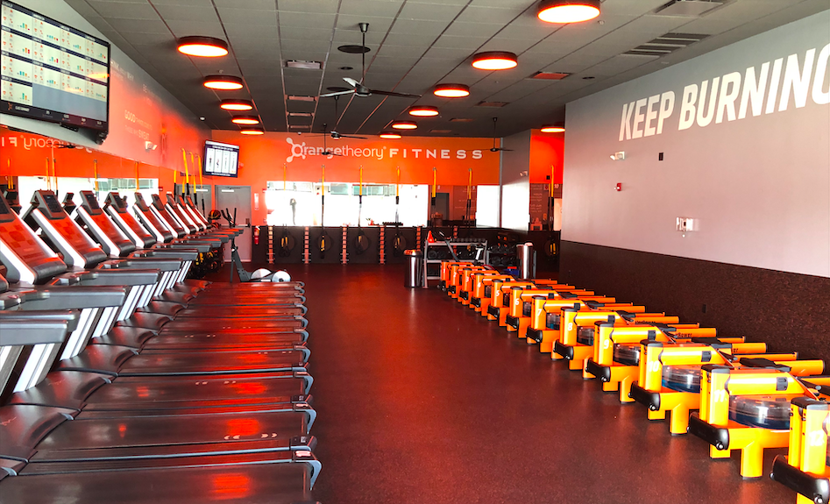
The Workout
Heart Rate Based training
Lead by certified instructors
Track and monitor results in real time

Slide 5
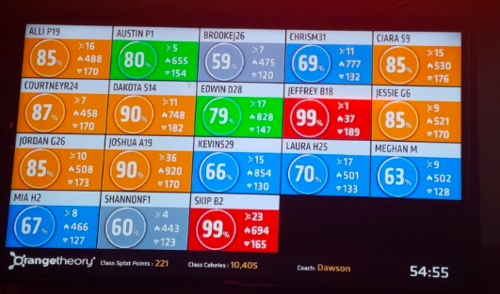
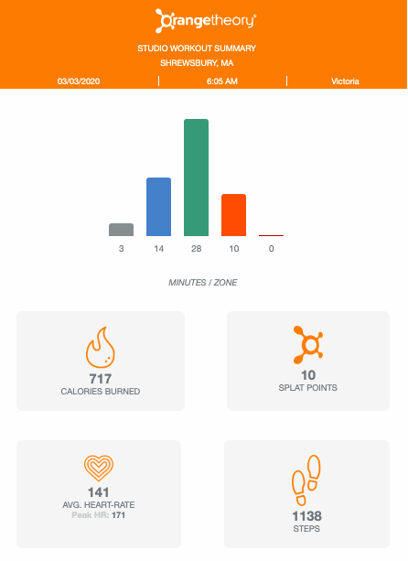
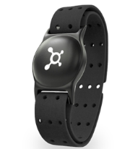
Technology

Slide 6
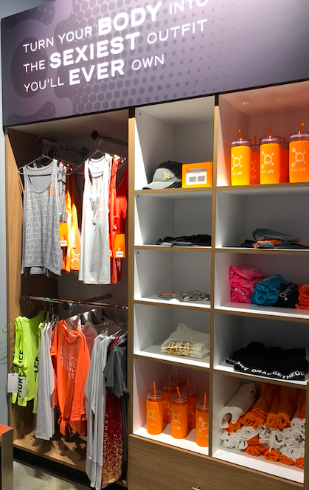
Products
Memberships
3 Monthly Membership Options
Class Packs
Retail
Water Bottles
Clothes
Body Composition Scans

Slide 7

Scope
1 Franchise locations
Shrewsbury, MA
730 Members
12 Employees
Salespeople, Coaches, Manager

Slide 8


Current Method of Reporting
Cloud-based online scheduling and other business management software as CRM
Workout summary for customers
Excel for reporting
NO BI

Slide 9
How BI can help Orangetheory Fitness
Operational
Sales Associates
Number of Calls
Sales (items and services)
Coaches
Attendance
Workouts for each day
Strategic
Managers
Total Sales
Revenue
Trends (members loss/gain and sales)
Predictive Analysis
Predict at risk members to increase retention rate

Slide 10
Dashboards

Slide 11
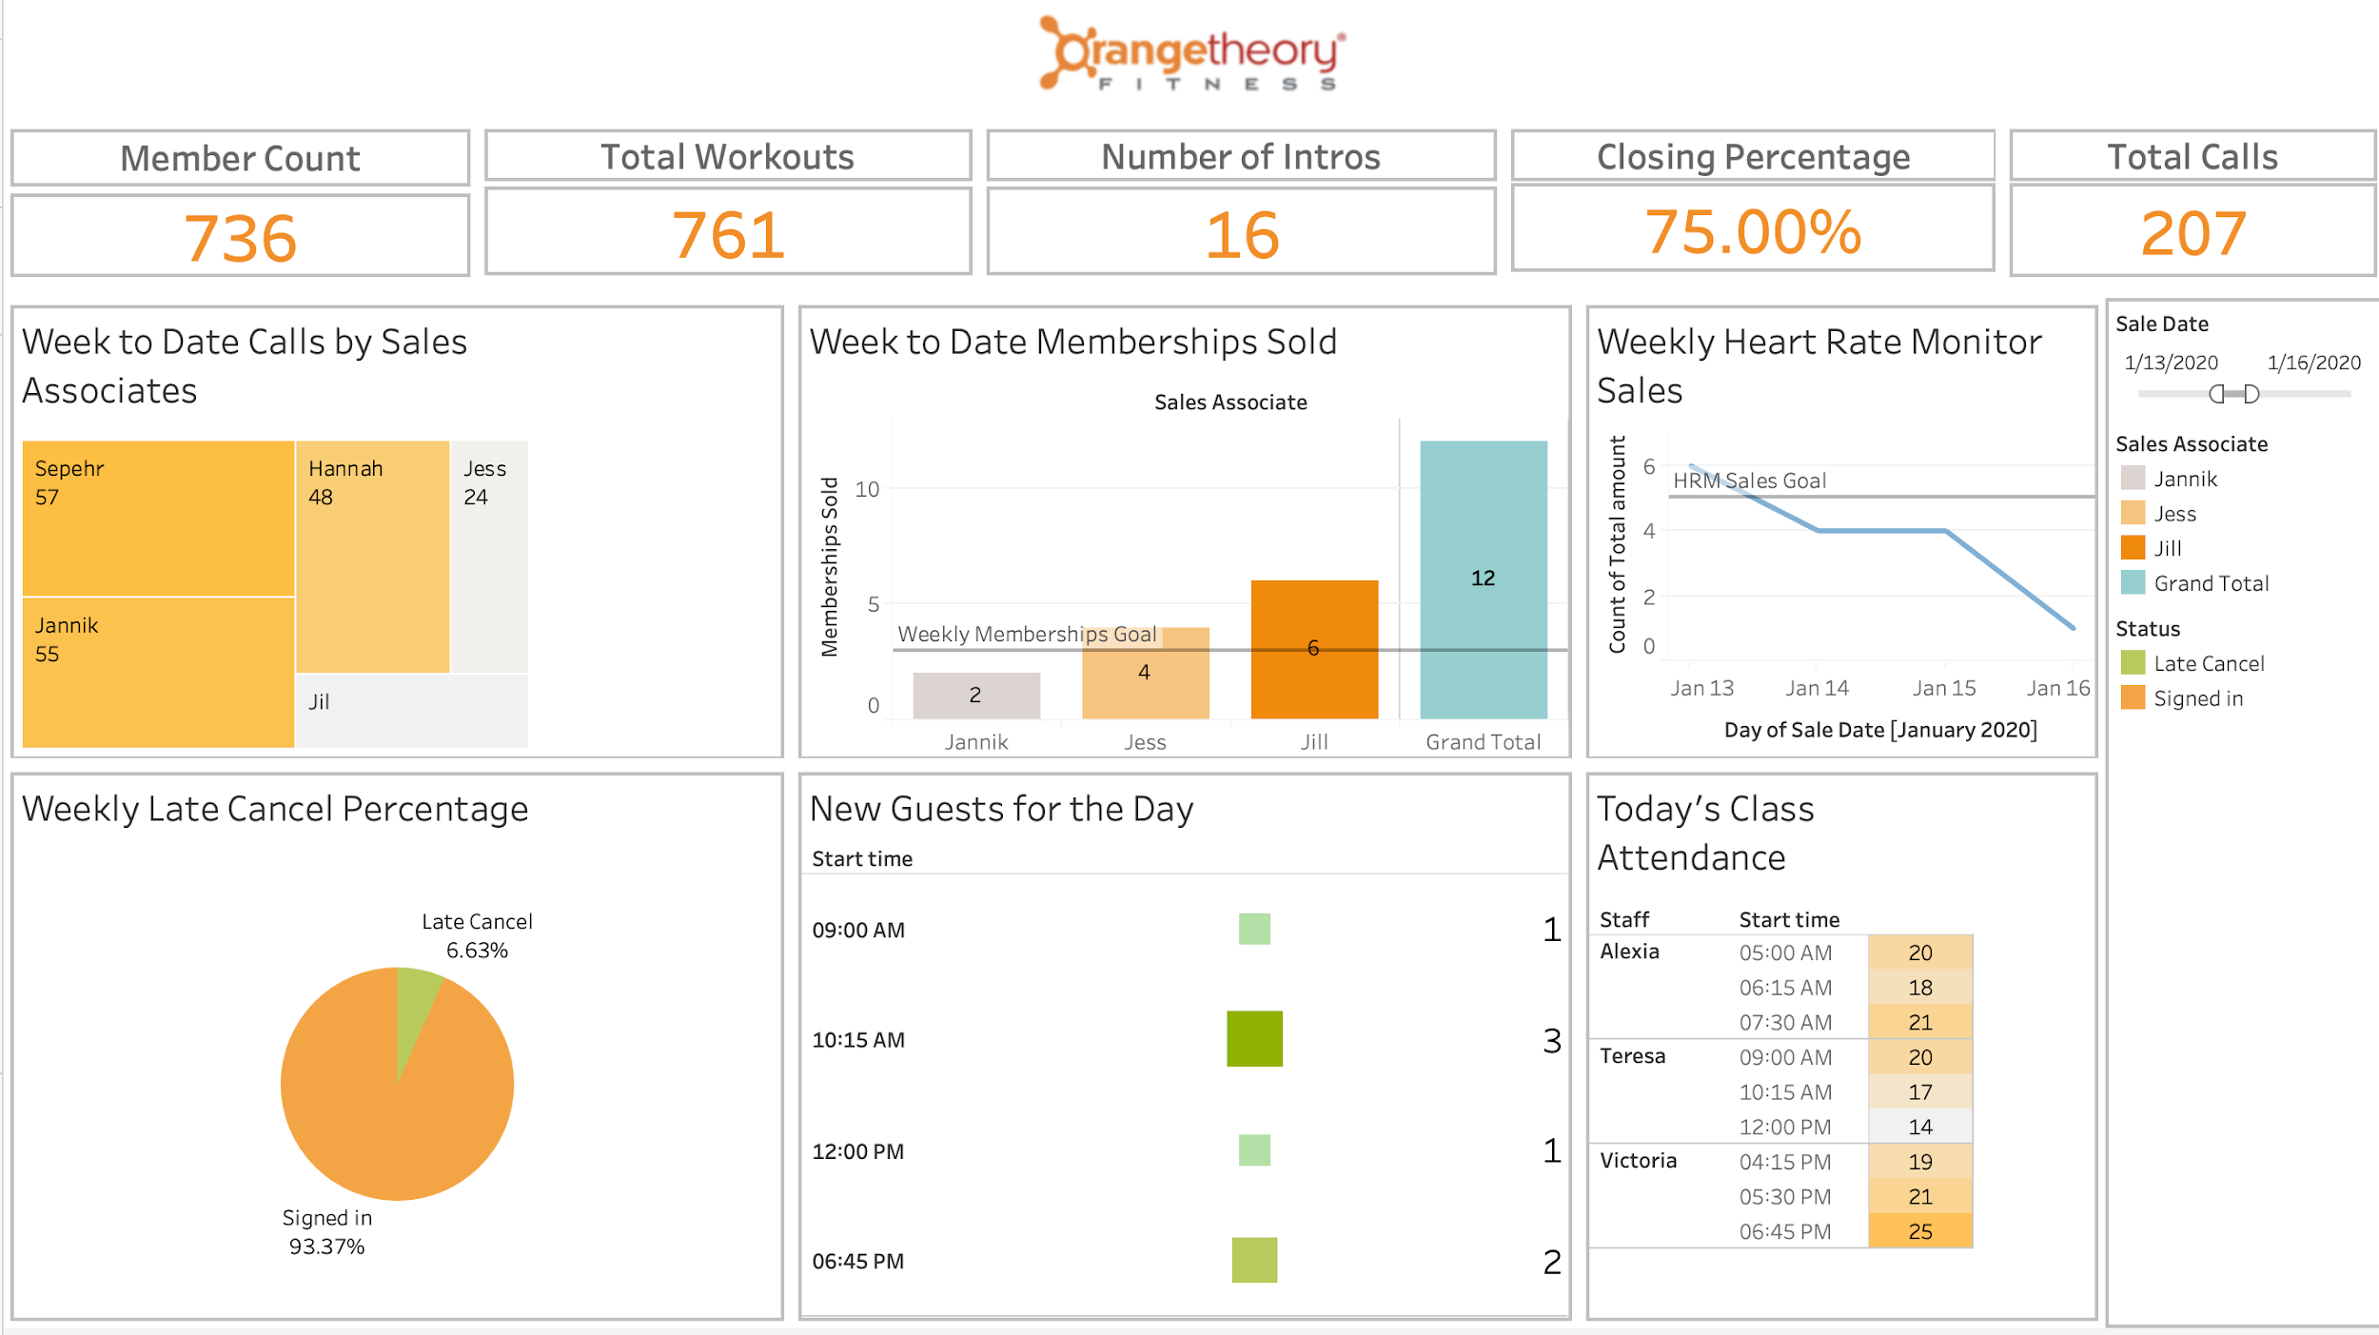
Operational

Slide 12
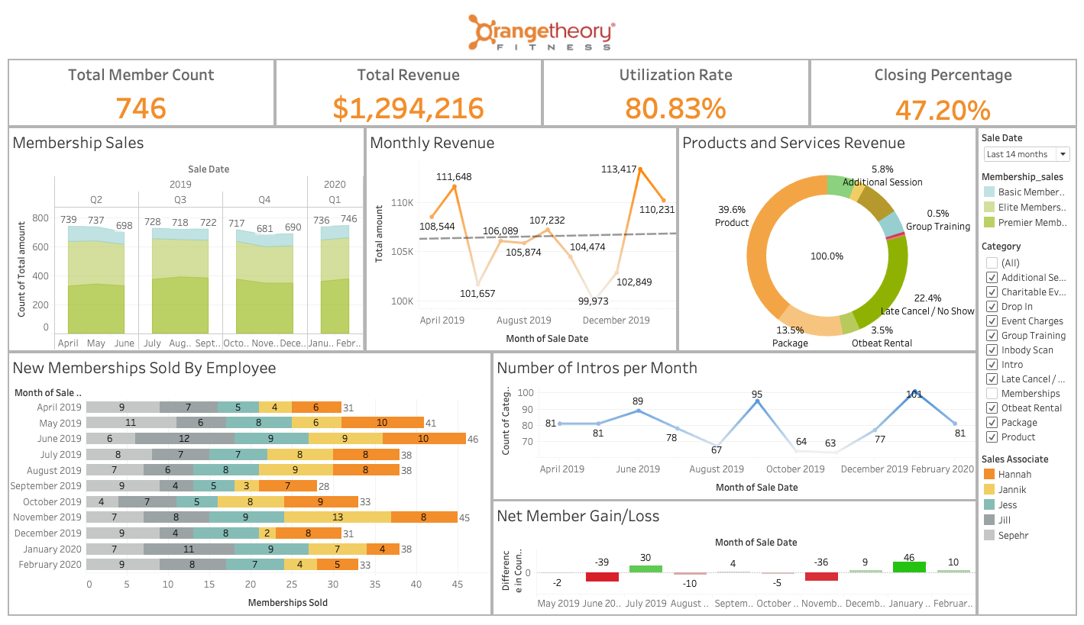
Strategic

Slide 13
Data Analysis

Slide 14

Member Retention Analysis
Group fitness studios report an average member retention rate of 75.9%
Equates to average churn rate of 24.1%

Slide 15

Telco Dataset (Kaggle)
19 Predictive features
Classified into churn (Yes/No)
Churn Rate = 26.58%

Slide 16

Results
82.6 % Prediction Accuracy
Decreased False Negative Rate to 7.4%
Feature Importance:
Contract Length, Tenure, Total Charges

Slide 17

Orangetheory Retention Rate
Suggested features:
Length of membership
Number of monthly classes
Number of days since last visit
Retail Purchases
Membership Type

Slide 18
Increasing Retention Rate
Generate list of members in danger of canceling
Focus efforts to retain these members
Free class or retail items
Personal message

Slide 19
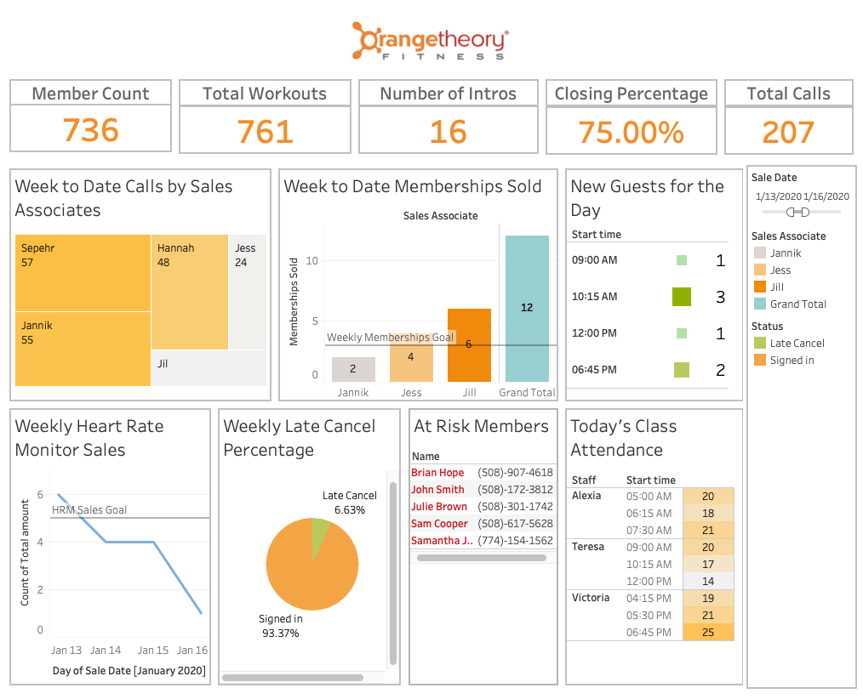

Slide 20
Implementation

Slide 21
Managerial Side
Planning
Articulate requirements and establish the KPIs required to be measured
Feedback
Collected from employees to inform the next iteration of implementation
Following Kotter’s 8 steps

Slide 22
Technical Side
Data storage
Data mart → Data warehouse
Data Collection
Star Schema/ Snowflake Schema
Too much detailed data → group them
Duplicated data → data deduplication
Non-standard data → standardize them
Data Quality
Data Visualization
Tableau

Slide 23
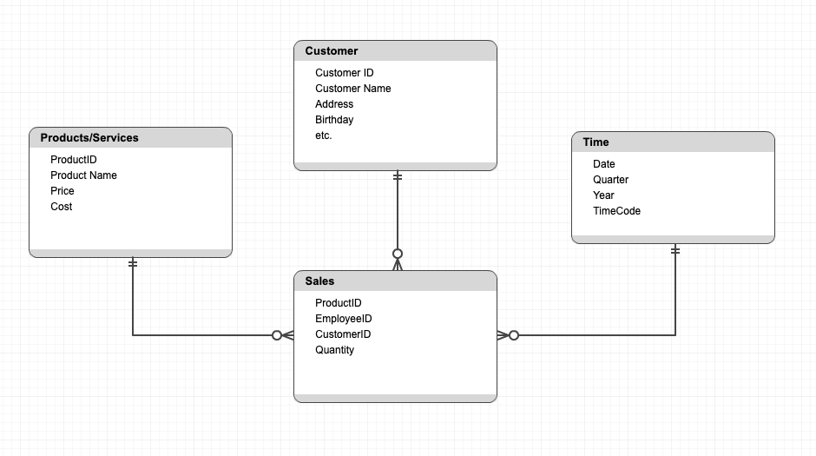
Star Schema

Slide 24
Conclusion
What our BI solution can do for Orangetheory:
Make daily operations more efficient and give real time performance feedback
Give a better overview of long-term performance
Provide valuable analysis to improve overall performance

Slide 25
Questions?

Slide 26
References
https://www.glofox.com/blog/the-gym-membership-retention-statistics-worth-retaining-in-2019/
https://www.dailydot.com/debug/orangetheory-fitness-problem/
https://www.orangetheoryfitness.com/
Raj, R., Wong, S. H., & Beaumont, A. J. (2016). Business Intelligence Solution for an SME: A Case Study.
https://aggora.co.uk/

